Slide 1
Chapter 8
Wireless network security

Slide 2
Microsoft improves security for Azure SQL Database http://www.networkworld.com/article/2993088/microsoft-improves-security-for-azure-sql-database.html?phint=newt%3Dnetworkworld_security_alert&phint=idg_eid%3Dc30d380502694c47d2c45cb7576fbd6b#tk.NWWNLE_nlt_security_2015-10-15
A new Always Encrypted feature will be available as a public beta by the end of the month. It allows users to encrypt sensitive data within an application using their own keys without relinquishing those keys to Azure SQL Database. It's a feature that lets companies maintain better control over critical applications they want to keep as secure as possible.
Microsoft's Transparent Data Encryption feature, which allows the encryption of a database without altering the application itself, will be generally available by the end of October. The company will automatically rotate the encryption keys for a database using the feature every 90 days, without end users having to worry about it.
Microsoft will now let users beta test authenticating to SQL Database using Azure Active Directory, so people who already connect to other services using Microsoft's cloud-based identity functionality will be able to access their databases through the same process.

Slide 3
Azure SQL
Users will also be able to try out a new Threat Detection feature, in public beta by the end of the month, that checks for suspicious activity at both the database and logical server level and then sends off alerts if it catches something anomalous. It's a tool that may help prevent massive data breaches, or at least mitigate the damage done if someone does manage to break into a database.
All of these upgrades are key, since Microsoft is in close competition with Amazon and Google to attract and retain cloud customers. Amazon Web Services chief Andy Jassy revealed last week that the company's Aurora managed relational database service is the fastest growing product in the cloud platform's stable.

Slide 4
Hijacking phones with radio waves, Siri and headphones. Should we worry? https://nakedsecurity.sophos.com/2015/10/15/hijacking-phones-with-radio-waves-siri-and-headphones-should-we-worry/?utm_source=Naked%2520Security%2520-%2520Feed&utm_medium=feed&utm_content=rss2&utm_campaign=Feed&utm_source=Naked+Security+-+Sophos+List&utm_campaign=b736a674a2-naked%252Bsecurity&utm_medium=email&utm_term=0_31623bb782-b736a674a2-455135885
Personal assistants on smartphones - Siri on the iPhone, Google Now on Androids, and Cortana on Windows Phone - allow us to do a lot of things with only a voice command.
We can make calls, send text messages, do web searches, and much more.
But what if someone else could make your phone do any of these things - silently, remotely, and without your knowledge?
A pair of French researchers have conceived an attack to remotely hijack phones with radio waves and, under very limited conditions, got it to work.
José Lopes Esteves and Chaouki Kasmi, researchers for the French infosec agency ANSSI, described the radio wave attack in a talk this summer at Hack in Paris, and recently published their findings in the journal IEEE Transactions on Electromagnetic Capability.
To make the attack work, the researchers sent FM radio signals from a laptop to an antenna, which transmits the signals to a nearby voice-command enabled phone with headphones plugged in.
In this attack, the headphone cord acts as an antenna, sending commands through the microphone to a digital assistant like Siri.

Slide 5
Hijacking phones II
the researchers demonstrated a few scenarios, such as turning the phone into an eavesdropping device by commanding it to make a call to an attacker's monitoring phone.
Or the attacker could make your phone visit a malicious phishing website, create embarrassing posts on your social media accounts, or launch a malicious app that could exploit download malware.
An attacker could also make money by forcing victims' phones to make expensive phone calls or send premium text messages, the researchers say.
These possibilities sound frightening, but the remote attack is quite difficult to pull off.
The researchers were only able to get their attack to work in a room shielded from outside electromagnetic interference, and with an antenna just six feet away from the victim phone (and even with a high-powered antenna the attack range only goes up to about 16 feet).
However, the researchers say, an attacker could hide an antenna in a backpack in a crowded area such as a train station or stadium and launch a massive attack on many people.

Slide 6
Assignment 2 solutions
Q1: If we add layers to a microkernel we can assign servers to different layers. Indicate:
The advantages of this approach
The disadvantages of the approach
Modify the class diagram of the microkernel to include the concept of layers.
Q2: Indicate the advantages and disadvantages of using public key certificates. Find three commercial systems where certificates are used to perform authentication.
Q3: The diagram of the Virtual Vault in slide 119 of Chapter 4 shows 4 partitions: Inside, Outside, System, and System Hi. Use a multilevel access control model for secrecy (Chapter 2) to protect the components shown in the diagram. For example, an attacker should not be able to deface the web pages or overwrite the audit trail.

Slide 7
Q1: If we add layers to a microkernel we can assign servers to different layers. Indicate: The advantages of this approach The disadvantages of the approach Modify the class diagram of the microkernel to include the concept of layers.
Advantages:
Keeps the advantages of the microkernel with 2 layers: flexibility, scalability, reference monitor for security,…
Can divide servers according to their level of trust. Similarly as done in the Intel X86 architecture.
Easy to implement in a ring architecture
We can use a multilevel model of access control as well as RBAC or access matrix—more flexible security
Disadvantages:
Overhead to perform checks for program requests as before
If servers need to communicate we need time to check (similar to gate crossing).

Slide 8
Q1: Extensions to the class diagram

Slide 9
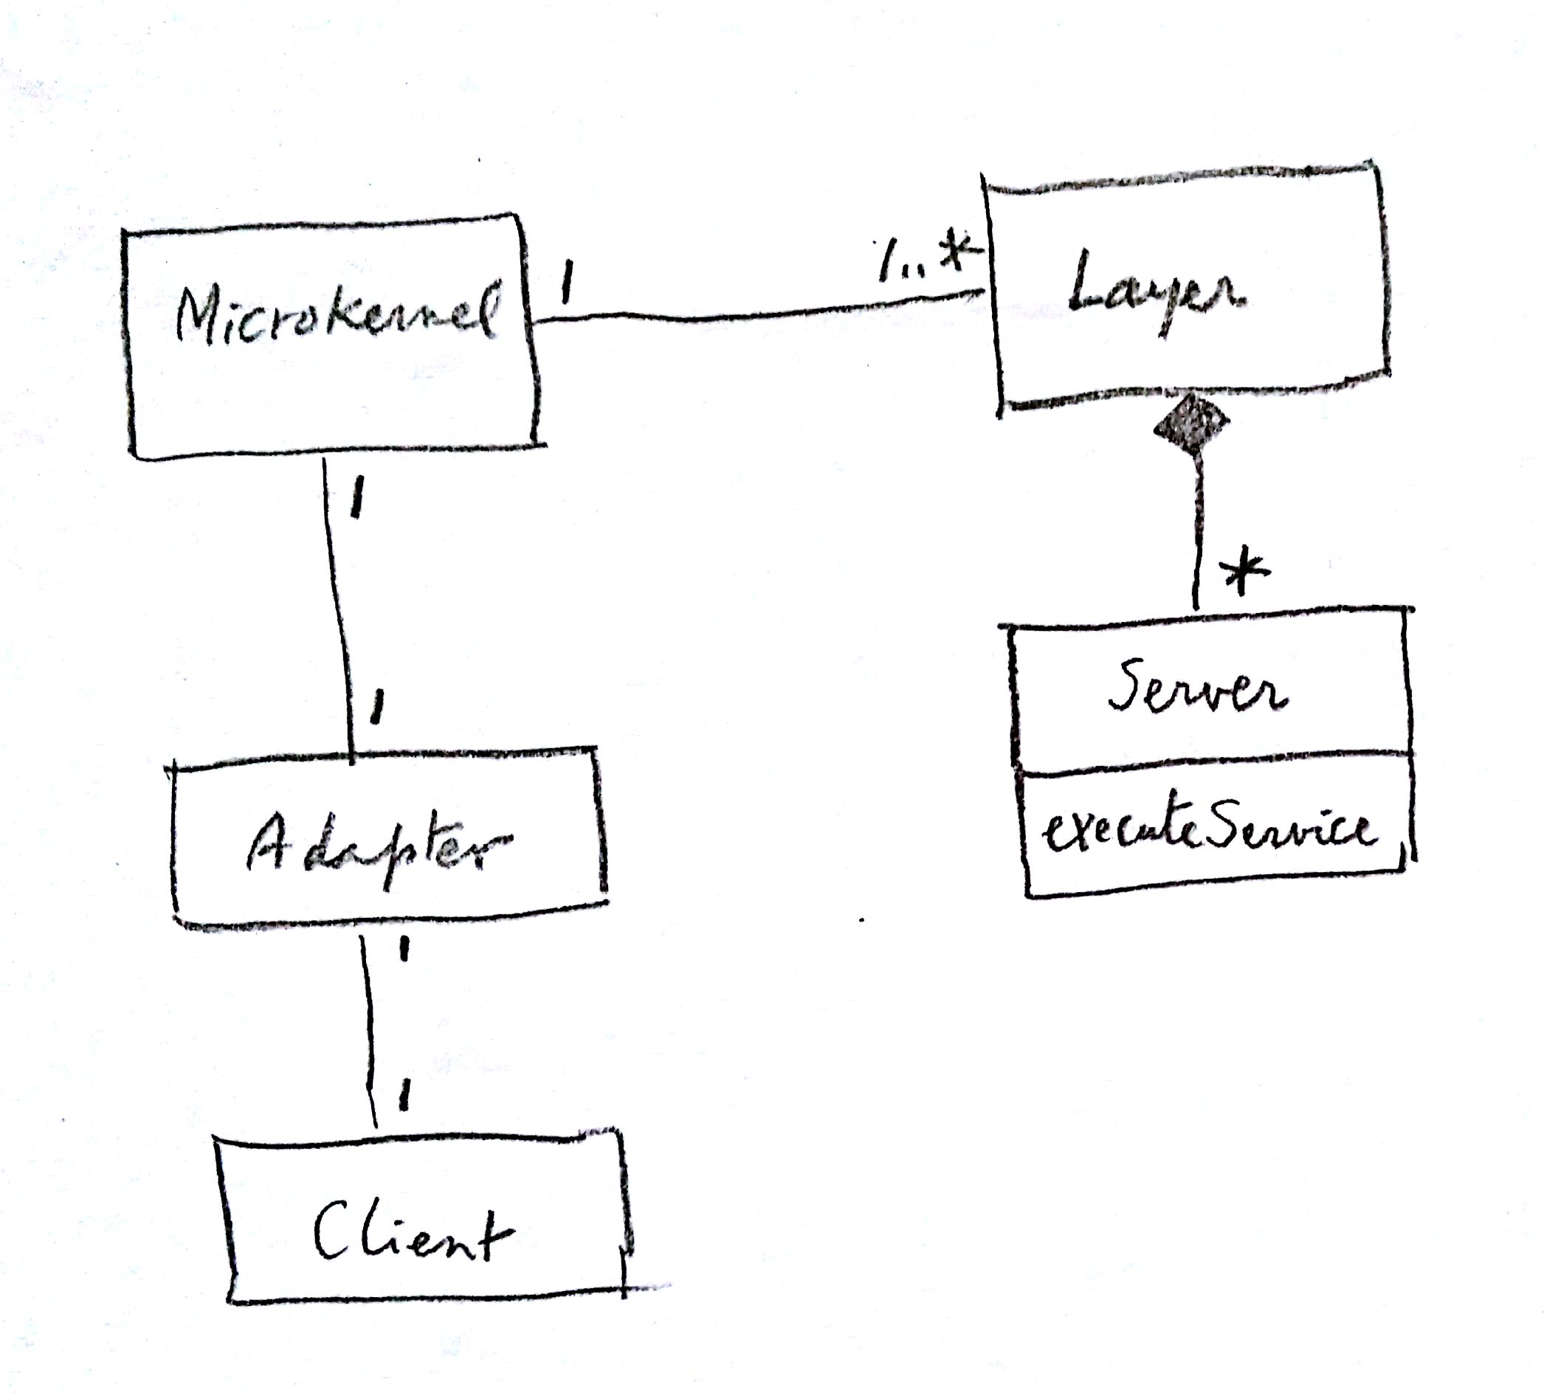

Slide 10
Q2: Indicate the advantages and disadvantages of using public key certificates. Find three commercial systems where certificates are used to perform authentication.
Advantages:
Portable authentication, carried by the process, that can be used in remote sites
A user can have several identities
Certificate can include information about authorization, roles, special privileges,…
Disadvantages:
Hard to revoke
Can be stolen because of their portability
Need recognized certification authority

Slide 11
Uses of certificates
1. USPS (United States Postal Service) uses PKI for authentication – as well as non-repudiation, data integrity, and confidentiality.
https://about.usps.com/doing-business/public-key-infrastructure/USPS_CP_V1.txt
2. Amazon.com – currently utilizing TLS https for secure login authentication, starting May 25, 2015 – upgraded to TLS due to man-in-the-middle vulnerability in SSL v3.0
https://sellercentral.amazon.com/forums/thread.jspa?threadID=252515
3. Amazon Web Services (including Amazon.com)-- supports https SSL for authentication
Recommended to all AWS clients for all API requests and authentication
https://aws.amazon.com/articles/1928
http://docs.aws.amazon.com/apigateway/latest/developerguide/getting-started-client-side-ssl-
authentication.html
4. Oracle--- uses public key cryptography in their SSL communications to provide authentication
https://docs.oracle.com/cd/B12037_01/network.101/b10777/galsyste.htm#1008003
https://docs.oracle.com/cd/B12037_01/network.101/b10777/galsyste.htm#1008119
University of Texas at Austin - Digital certificates are offered to faculty and staff as a tool for signing and encrypting email and other important electronic documents. https://www.utexas.edu/its/help/digital-certificates/845

Slide 12
Q3: The diagram of the Virtual Vault in slide 119 of Chapter 4 shows 4 partitions: Inside, Outside, System, and System Hi. Use a multilevel access control model for secrecy (Chapter 2) to protect the components shown in the diagram. For example, an attacker should not be able to deface the web pages or overwrite the audit trail.

Slide 13
Q3 answer
Assume that Outside can be captured by the attacker (it is the only partition with external access)
Assign Outside to level 2 so we can control actions above and below this level
System is in level 1, so the attacker can read it but not overwrite the web pages or the CGI scripts
System Hi is in level 3 and the attacker cannot read the log. He can append information to it but not change the old information.
Inside is in level 4 and the attacker cannot read or overwrite its functions (CGI, web services,…). Same as level 3 plus gateway control

Slide 14
Assignment 3 (due Mon. Nov 9)
Write a misuse pattern for Stuxnet. Describe only sections Intent, Solution, Known Uses, and References
Define a relational database (a few tables) for the Travel agency of Assignment 1 and write the 8 authorization rules as SQL Authorization rules.
Summarize the main points of 3GPP LTE security. Give references.

Slide 15
Security firm CrowdStrike says attackers try to breach tech, pharma companies http://www.networkworld.com/article/2994383/security/china-reportedly-tries-to-hack-u-s-businesses-the-day-after-agreeing-not-to.html?phint=newt%3Dnetworkworld_daily_news_alert&phint=idg_eid%3Dc30d380502694c47d2c45cb7576fbd6b#tk.NWWNLE_nlt_daily_pm_2015-10-19
Chinese hackers have gone after seven U.S. tech and pharmaceutical companies since the presidents of both countries agreed not to knowingly carry out corporate espionage, according to security firm CrowdStrike.
The company says in a blog post that it has identified a known hacking group in China as intruding into the seven U.S. companies starting the day after Presidents Xi and Obama announced the pact.
Some of these attacks were carried out by a group known as Deep Panda, which CrowdStrike describes as “one of the most advanced Chinese nation-state cyber intrusion groups,” which has been tied for years to break-ins that target national security assets as well as industries including agriculture, chemical, financial, healthcare, insurance, legal and technology.
The means of attack included compromising Web servers via SQL injection in order to implant China Chopper Web shells that gives attackers the ability to upload further malware, typically credential-stealing code to escalate network privileges. Other tools used by the attackers included remote-access Trojans Derusbi and Plug X.
The attacks were all against CrowdStrike customers and all were blocked by its Falcon platform, the company says.

Slide 16
Derusbi malware https://www.novetta.com/wp-content/uploads/2014/11/Derusbi.pdf
There are two types of Derusbi malware: a client server model and a server client model. Both types provide basic RAT functionality with the distinction between the two being largely the directionality of the communication.
The server client variant of Derusbi acts as a server on a victim’s machine and waits for commands from a controlling client. In and of itself, the Derusbi server variant is a largely unremarkable RAT when viewed from the perspective of functional capabilities.
The server variant supports basic RAT functionality such as file management (uploading and downloading ), network tunneling and remote command shell.
What makes the server variant interesting is the device driver that the variant installs. The server variant utilizes a device driver in order to hook into the Windows firewall by either using largely undocumented Windows Firewall hooking techniques found in Windows XP and older or by using the documented Windows Filtering Platform found in Windows Vista and later.
The driver, after hooking the firewall using either of the two mentioned interfaces, will inspect incoming network packets. If a specific handshake occurs between the client and the server variant, the remainder of the communication session for the established session will be redirected to the server variant.
If the driver does not detect the appropriate handshake, then the network traffic is allowed to pass unobstructed. This allows an attacker to hide their communication within a cluster of network sessions originating from a single IP

Slide 17
Trip to the Pattern Languages of Programs Conference
Pittsburgh, PA, October 24-26, 2015
Madiha H. Syed and Eduardo B. Fernandez, “The Software Container pattern”, 22nd Conference on Pattern Languages of Programs) 2015,
Rohini Sulatycki and Eduardo B. Fernandez, “A threat pattern for the “Cross-Site Scripting (XSS)” attack”, 22nd Conference on Pattern Languages of Programs) 2015
Class of Tuesday, Oct. 27 will be taught by Dereje Yimam (PhD candidate). He will report on his trip to Amazon conference; in particular security aspects

Slide 18
Wireless devices
Typically small memory, low processing power, unreliable communications
Include laptops, PDAs, pagers, smart cellular phones:
Use IEEE 802.11 wireless LAN standard, or Bluetooth, or GSM, or CDMA for communications

Slide 19
IEEE 802.11
Standards for communication in the 2.4, 3.6 and 5 GHz frequency bands
Several protocols 11a,b,c…z
Wi-Fi is a trademark of the WiFi Alliance that manufacturers may use to brand certified products based on 802.11
The protocol resides in the physical and data link layers of the OSI model
It defines functions and specifications for the physical and MAC (Medium Access) layers
The MAC layer covers three functional areas: Reliable data delivery, access control, and security

Slide 20
802.11--more
The protocol defines different building blocks: BSS (Basic Service Set) and ESS (Extended Service Set)
Each ESS consists of one or more BSS
Stations in a BSS compete for access to the shared wireless medium

Slide 21
Bluetooth
Bluetooth is a wireless communications protocol, originated by Ericsson, Sweden
It is intended to work in a close proximity environment, such as homes, offices, classrooms, hospitals, airports, etc.
A packet-based master - slave protocol (1 to 7): A piconet
It competes with small distance applications of 802.11
IBM, Intel, Nokia and Toshiba were the first supporters but now IEEE is using it as the basis for its 802.15.1 standard
Bluetooth uses application profiles for different devices, synchronous connection-oriented (SCO) for data, and asynchronous connectionless (ACL) links for voice, which are multiplexed on the same RF link
Bluetooth uses a radio technology called frequency-hopping spread spectrum, which chops up the data being sent and transmits chunks of it on up to 79 bands (1 MHz each) in the range 2402-2480 MHz.

Slide 22
Global System for Mobile Comm. (GSM)
Cellular communications based on frequency reuse: sets of N channels assigned to each cell
A Base Station Subsystem (BSS) in each cell
A Mobile Switching Center (MSC) for several cells
900-1800-1900 MHz frequency bands
TDMA used for assigning slots to MSC
FDMA used across cells

Slide 23
Wired Equivalent Privacy
Wired Equivalent Privacy (WEP) is a security algorithm for IEEE 802.11 wireless networks
It was intended to provide confidentiality comparable to that of a traditional wired network
Since 2001, several serious weaknesses in the protocol have been identified with the result that today a WEP connection can be cracked with readily available software within minutes
In response to vulnerabilities the IEEE created a new 802.11i task force, by 2003 they announced that WEP had been superseded by Wi-Fi Protected Access (WPA)
Finally in 2004, with the ratification of the full 802.11i standard (i.e., WPA2), the IEEE declared that both WEP-40 and WEP-104 "have been deprecated as they fail to meet their security goals“
Despite its weaknesses, WEP is still widely in use and is often the first security choice presented to users by router configuration tools

Slide 24
WEP idea
WEP was included as the privacy of the original standard ratified in September 1999
WEP uses the stream cipher RC4 for confidentiality and the CRC-32 checksum for integrity
Standard 64-bit WEP uses a 40-bit key (also known as WEP-40), which is concatenated with a 24-bit initialization vector (IV) to form the RC4 traffic key
It was deprecated as a wireless privacy mechanism in 2004, but for legacy purposes is still documented in the current standard

Slide 25
WEP algorithm

Slide 26
WEP use
A 128-bit WEP key is almost always entered by users as a string of 26 hex (base 16) characters (0-9 and A-F). Each character represents four bits of the key. 26 digits of four bits each gives 104 bits; adding the 24-bit IV produces the final 128-bit WEP key.
A 256-bit WEP system is available from some vendors, and as with the 128-bit key system, 24 bits of that is for the IV, leaving 232 actual bits for protection. These 232 bits are typically entered as 58 hexadecimal characters. (58 × 4 = 232 bits) + 24 IV bits = 256-bit WEP key.
Key size is not the only major security limitation in WEP
Cracking a longer key requires interception of more packets, but there are active attacks that stimulate the necessary traffic
There are other weaknesses in WEP, including the possibility of IV collisions and altered packets, that are not helped at all by a longer key.

Slide 27
WEP attacks
Because RC4 is a stream cipher, the same traffic key must never be used twice. The purpose of an IV, which is transmitted as plain text, is to prevent any repetition, but a 24-bit IV is not long enough to ensure this on a busy network
The way the IV was used also opened WEP to a related key attack. For a 24-bit IV, there is a 50% probability the same IV will repeat after 5000 packets.
Cam-Winget et al. (2003) surveyed a variety of shortcomings in WEP. They write "Experiments in the field indicate that, with proper equipment, it is practical to eavesdrop on WEP-protected networks from distances of a mile or more from the target." They also reported two generic weaknesses:
the use of WEP was optional, resulting in many installations
never even activating it, and
WEP did not include a key management protocol, relying instead on a single shared key among users

Slide 28
Cards
In 2008, Payment Card Industry (PCI) Security Standards Council’s latest update of the Data Security Standard (DSS), prohibits the use of the WEP as part of any credit-card processing after 30 June 2010, and prohibit any new system from being installed that uses WEP after 31 March 2009
The use of WEP contributed to the T.J. Maxx parent company network invasion

Slide 29
WPA
Wi-Fi Protected Access (WPA and WPA2) is a certification program developed by the Wi-Fi Alliance to indicate compliance with the security protocol created by the alliance to secure wireless computer networks
he WPA protocol implements the majority of the IEEE 802.11i standard
Specifically, the Temporal Key Integrity Protocol (TKIP), was brought into WPA
TKIP could be implemented on pre-WPA cards that began shipping as far back as 1999 through upgrades
Because the changes required fewer modifications on the client than on the APs, most pre-2003 APs could not be upgraded to support WPA with TKIP
Researchers have since discovered a flaw in TKIP that relied on older weaknesses to retrieve the keystream from short packets to use for re-injection and spoofing

Slide 30
WPA2
WPA2 has replaced WPA and requires testing and certification by the Wi-Fi Alliance
WPA2 implements the mandatory elements of 802.11i
In particular, it introduces CCMP, a new AES-based encryption mode with strong security
Certification began in September, 2004; from March 13, 2006, WPA2 certification is mandatory for all new devices to bear the Wi-Fi trademark

Slide 31
WiMax architecture
How do we let subscriber (user) stations communicate with each other through long distances (up to 30 miles) using wireless networks?
Make Subscriber Stations (SSs) communicate with a Base Station (BS) through wireless links. The Base Station connects all subscribers.
Use a layered architecture that supports different protocols in different layers.
Support multiple message types and sub-layers within layers, e.g. for mapping message elements across protocols and for security.

Slide 32
3GPP Long Term Evolution (LTE)
It is the latest standard in the mobile network technology tree that previously realized the GSM/EDGE and UMTS/HSxPA network technologies
It is a project of the 3rd Generation Partners Project (3GPP)
The current generation of mobile telecommunication networks are collectively known as 3G (for "third generation"). Although LTE is often marketed as 4G, first-release LTE is actually a 3.9G technology since it does not fully comply with the Advanced 4G requirements
Verizon and AT&T Mobility in the United States and several worldwide carriers announced plans, beginning in 2009, to convert their networks to LTE
The world's first publicly available LTE-service was opened by TeliaSonera in Sweden on the 14th of December 2009.
LTE is a set of enhancements to the Universal Mobile Telecommunications System (UMTS) which was introduced in 3rd Generation Partnership Project (3GPP) Release 8. Much of 3GPP Release 8 focuses on adopting 4G mobile communication's technology, including an all-IP flat networking architecture
While it is commonly seen as a mobile telephone or common carrier development, LTE is also endorsed by public safety agencies in the US as the preferred technology for the new 700 MHz public-safety radio band
Samsung just tested WiMAX 2 (802.16m) at 330 Mbps

Slide 33
Six Years After Big Breach, Just 16 Percent of VA Computers are Encrypted (October 19, 2012) SANS NewsBites Vol. 14 Num. 85
More than six years after a major data security breach, the US Department of Veterans Affairs (VA) has still not encrypted the majority its computers. In the spring of 2006, computer equipment containing the personally identifiable information of 26 million US veterans was stolen from the home of a VA employee. Shortly after the incident, then-VA Secretary James Nicholson ordered that all VA PCs and laptops be protected with encryption. The department spent US $6 million on encryption software. According to the results of aninvestigation conducted by the department's inspector general, just 16 percent of VA computers are currently protected with encryption. [Editor's Note (Murray): The issue should not be what percentage of computers are encrypted but what percentage of the sensitive data is protected. While sensitive data stored on personal computers and laptops should be encrypted, sensitive data should be stored on enterprise servers, not personal computers and laptops.]

Slide 34
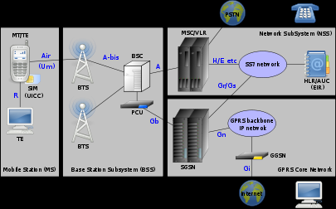
GSM

Slide 35
GSM architecture
The BaseStation Subsystem (the base stations and their controllers).
the Network and Switching subsystem (the part of the network most similar to a fixed network). This is sometimes also just called the core network.
The GPRS Core network (the optional part which allows packet based Internet connections).
The Operational Support system (OSS) for maintenance of the network

Slide 36
SIM
One of the key features of GSM is the Subscriber Identity Module, SIM. The SIM is a detachable smart card containing the user's subscription information and phone book
This allows the user to retain his or her information after switching handsets
Alternatively, the user can also change operators while retaining the handset simply by changing the SIM
Some operators will block this by allowing the phone to use only a single SIM, or only a SIM issued by them; this practice is known as SIM locking and is illegal in some countries

Slide 37
3G Protocols
Universal Mobile Telecommunications System (UMTS) is intended to be the worldwide standard for 3G cellular communications supporting high quality video and other services.
UMTS security is based on GSM security with several enhancements. The network and the handset both authenticate themselves to each other, integrity keys are used in addition to encryption keys, and the encryption algorithms are stronger
The triplet sent from the AuC has been extended to a quintet with the addition of a 128 bit integrity key (IK) and a network authentication token (AUT)
The A3/A8 algorithm has been replaced with an UEA1 algorithm based on the Kasumi block cipher, and is performed in the handset, where more computing power is available
The session cipher key is 128 bits, while the transmission stream cipher (UEA) uses the bearer identity and direction of transmission in addition to the cipher key and frame number, and the frame number is considerably larger.

Slide 38
Kasumi
KASUMI is a block cipher used in mobile communications.
In UMTS KASUMI is used in the confifentiality (f8) and integrity algorithms (f9) with names UEA1 and UIA1, respectively. In GSM KASUMI is used in the A5/3 key stream generator and in GPRS in the GEA3 key stream generator.
KASUMI was designed for 3GPP to be used in UMTS security system by the Security Algorithms Group of Experts (SAGE), a part of the European standards body ETSI
Because of schedule pressures in 3GPP standardization, instead of developing a new cipher, SAGE agreed with 3GPP technical specification group (TSG) for system aspects of 3G security (SA3) to base the development on an existing algorithm that had already undergone some evaluation. They chose the cipher algorithm MISTY1 developed and patented by Mitsubishi. The original algorithm was slightly modified for easier HW implementation and to meet other requirements set for 3G mobile communications security.
KASUMI is named after the original algorithm Misty — kasumi (霞) is the Japanese word for "mist".
In January 2010, Orr Dunkelman, Nathan Keller, and Adi Shamir, released a paper showing that they could break Kasumi with related key attack and very modest computational resources. Interestingly, the attack is ineffective against MISTY

Slide 39
GSM security
GSM was designed with a moderate level of service security. The system was designed to authenticate the subscriber using a shared key and challenge-response. Communications between the subscriber and the base station can be encrypted
UMTS introduces an optional Universal Subscriber Identity Module (USIM), that uses a longer authentication key to give greater security, as well as mutually authenticating the network and the user - whereas GSM only authenticates the user to the network (and not vice versa). The security model therefore offers confidentiality and authentication, but limited authorization capabilities, and no non-repudiation
GSM uses several cryptographic algorithms for security. The A5/1 and A5/2 stream cipher; A5/2 is weaker. Serious weaknesses have been found in both algorithms: it is possible to break A5/2 in real-time with a ciphertext-only attack, and in February 2008, Pico Computing, Inc revealed its ability and plans to commercialize FPGAs that allow A5/1 to be broken with a rainbow table attack. The system supports multiple algorithms so operators may replace that cipher with a stronger one.

Slide 40
GSM sec II
On 28 December 2009 German computer engineer K. Nohl announced that he had cracked the A5/1 cipher.] According to Nohl, he developed a number of rainbow tables (static values which reduce the time needed to carry out an attack) and found new sources for known plaintext attacks. He also said that it is possible to build "a full GSM interceptor ... from open source components" but that they had not done so because of legal concerns.
In 2010, threatpost.com reported that "A group of cryptographers has developed a new attack that has broken Kasumi, the encryption algorithm used to secure traffic on 3G GSM wireless networks. The technique enables them to recover a full key by using a tactic known as a related-key attack, but experts say it is not the end of the world for Kasumi." Kasumi is the name for the A5/3 algorithm, used to secure most 3G traffic.
Although security issues remain for GSM newer standards and algorithms may address this. New attacks are growing in the wild which take advantage of poor security implementations, architecture and development for smart phone applications. Some wiretapping and eavesdropping techniques hijack the audio input and output providing an opportunity for a 3rd party to listen in to the conversation. This threat is mitigated by the fact the attack has to come in the form of a Trojan or a virus and might be detected by security software

Slide 41
IRS future security improvements
Review the transmission of the tax return, including the improper and/or repetitive use of Internet Protocol numbers, the Internet ‘address’ from which the return is originating.
Review computer device identification data tied to the return’s origin.
Review the time it takes to complete a tax return, so computer mechanized fraud can be detected.
Capture metadata in the computer transaction that will allow review for identity theft related fraud.
New password standards to access tax software will require a minimum of eight characters with upper case, lower case, alpha, numerical and special characters.
A new timed lockout feature and limited unsuccessful log-in attempts.
The addition of three security questions.
Out-of-band verification for email addresses, which is sending an email or text to the customer with a PIN – a common practice used throughout the financial sector.

Slide 42
Crypto researchers: Time to use something better than 1024-bit encryption http://www.networkworld.com/article/2994934/security/crypto-researchers-time-to-use-something-better-than-1024-bit-encryption.html?phint=newt%3Dnetworkworld_daily_news_alert&phint=idg_eid%3Dc30d380502694c47d2c45cb7576fbd6b#tk.NWWNLE_nlt_daily_am_2015-10-20
It’s actually possible for entities with vast computing resources – such as the NSA and major national governments - to compromise commonly used Diffie-Hellman key exchange groups, so it’s time for businesses to switch to something else like elliptic curve cryptography, researchers say.
“It’s been recommended to move from 1024-bit [encryption] for a long time, and now there are very concrete risks of not doing that,” says Nadia Heninger, an assistant professor of computer and information science at the University of Pennsylvania who is an author of a paper titled “Imperfect Forward Secrecy: How Diffie-Hellman Fails in Practice”.

Slide 43
CSO salaries expected to sky rocket http://www.networkworld.com/article/2995046/careers/cso-salaries-expected-to-sky-rocket.html?nsdr=true
2016 may emerge as the year of the chief security officer, as another new study reveals that pay for CSOs is rising faster than most every other IT job.
According to the 2016 Technology Salary Survey released this month by Robert Half Technology, top CSOs can now expect to earn just under a quarter million dollars in base pay.

Slide 44
Salaries for 2016
Title | 2015 | 2016
CSO | $134,250-$204,750 | $140,250-$222,500
Data Security Analyst | $106,250-$149,000 | $113,500-$160,000
Systems Security Administrator | $100,000-$14,0250 | $105,500-$149,500
Network Security Administrator | $99,250-$138,500 | $103,250-$147,000
Network Security Engineer | $105,000-$141,500 | $110,250-$152,750
Information Systems Security Manager | $122,250-$171,250 | $129,750-$182,000

Slide 45
Trip to the Pattern Languages of Programs Conference
Pittsburgh, PA, October 24-26, 2015
Madiha H. Syed and Eduardo B. Fernandez, “The Software Container pattern”, 22nd Conference on Pattern Languages of Programs 2015,
Rohini Sulatycki and Eduardo B. Fernandez, “A threat pattern for the “Cross-Site Scripting (XSS)” attack”, 22nd Conference on Pattern Languages of Programs 2015
Y. Ito, H. Washizaki, M. Yoshizawa, Y. Fukazawa, T. Okubo, H. Kaiya, H. Haseyama, N. Yoshioka, E.B. Fernandez, “Systematic Mapping of Security Patterns Research”, 22nd Conference on Pattern Languages of Programs 2015
SPLASH, October 28, 2015
Tutorial on Security Patterns

Slide 46
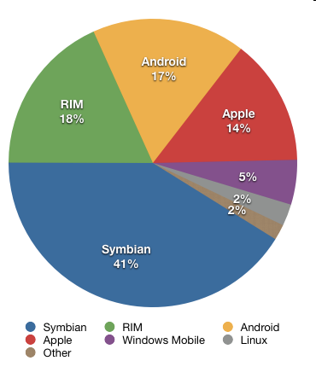
2Q 2010 sales of wireless operating systems

Slide 47
Android sales 2012
Samsung Electronics Co. and other phone makers shipped nearly 105 million Android smartphones in the April-June quarter, giving Android 68 percent of the worldwide market, up from 47 percent last year.
The gains came largely at the expense of BlackBerry phones and Symbian phones made largely by Nokia Corp. Each saw its market share drop below 5 percent. Nokia is now making phones that use Microsoft Corp.'s Windows system.
The market share for Apple Inc.'s iPhone, powered by its iOS software, fell slightly to 17 percent, from 19 percent. But the company shipped more iPhones than a year ago. Apple is the No. 2 smartphone maker, behind Samsung, and is likely to get a boost when it releases its new iPhone model.

Slide 48
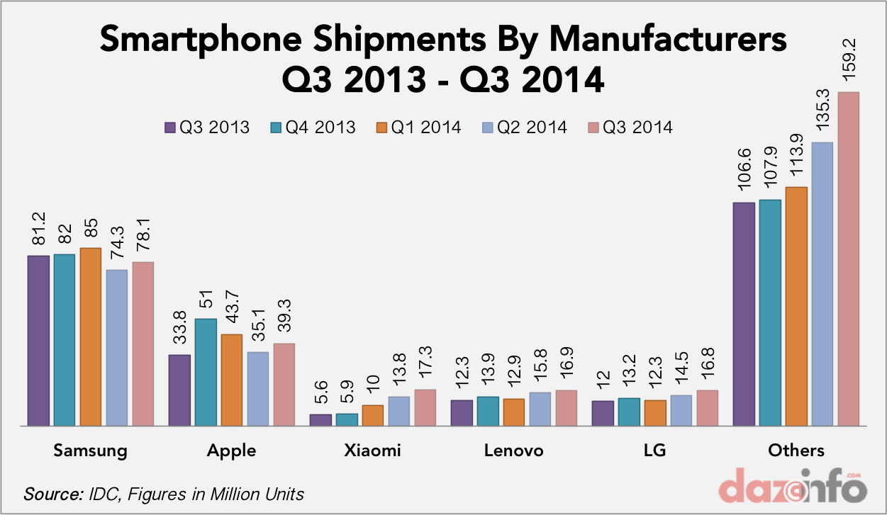

Slide 49
Smartphone sales Aug. 2015 http://www.gartner.com/newsroom/id/3115517
Gartner, Inc. said worldwide smartphone sales recorded the slowest growth rate since 2013 in the second quarter of 2015. Worldwide sales of smartphones to end users totaled 330 million units, an increase of 13.5 percent over the same period in 2014 (see Table 1).
"While demand for lower-cost 3G and 4G smartphones continued to drive growth in emerging markets, overall smartphone sales remained mixed region by region in the second quarter of 2015" . Emerging Asia/Pacific (excluding China), Eastern Europe and Middle East and Africa were the fastest-growing regions, driven by good performance from Chinese and local vendors. By contrast, smartphone sales in China fell for the first time year over year, recording a 4 percent decline.
"China is the biggest country for smartphone sales, representing 30 percent of total sales of smartphones in the second quarter of 2015. Its poor performance negatively affected the performance of the mobile phone market in the second quarter". "China has reached saturation — its phone market is essentially driven by replacement, with fewer first-time buyers. Beyond the lower-end phone segment, the appeal of premium smartphones will be key for vendors to attract upgrades and to maintain or grow their market share in China."

Slide 50
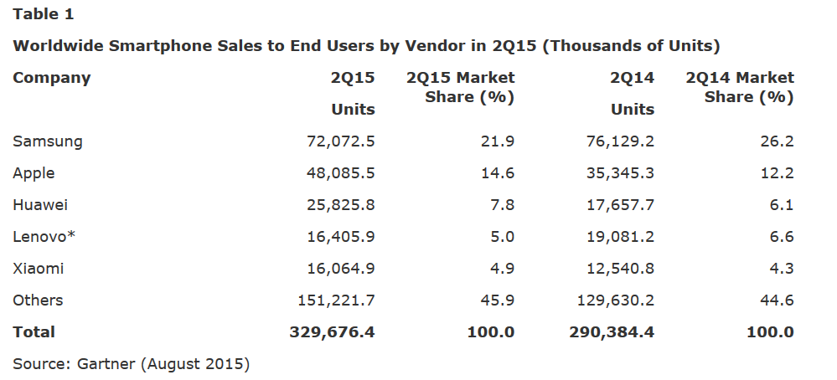

Slide 51
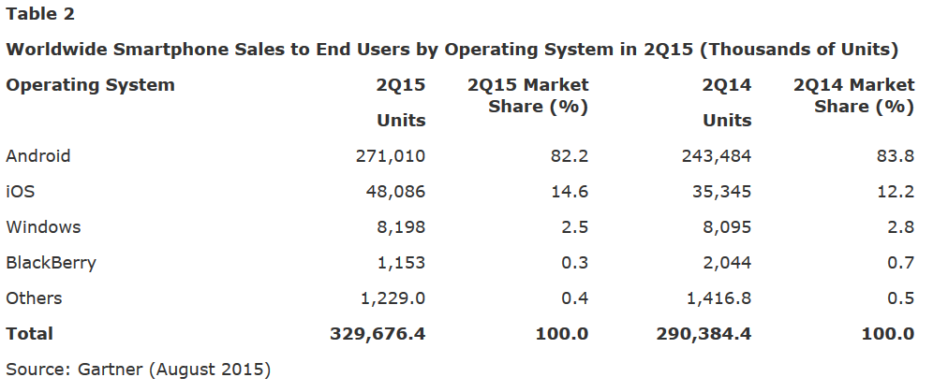

Slide 52
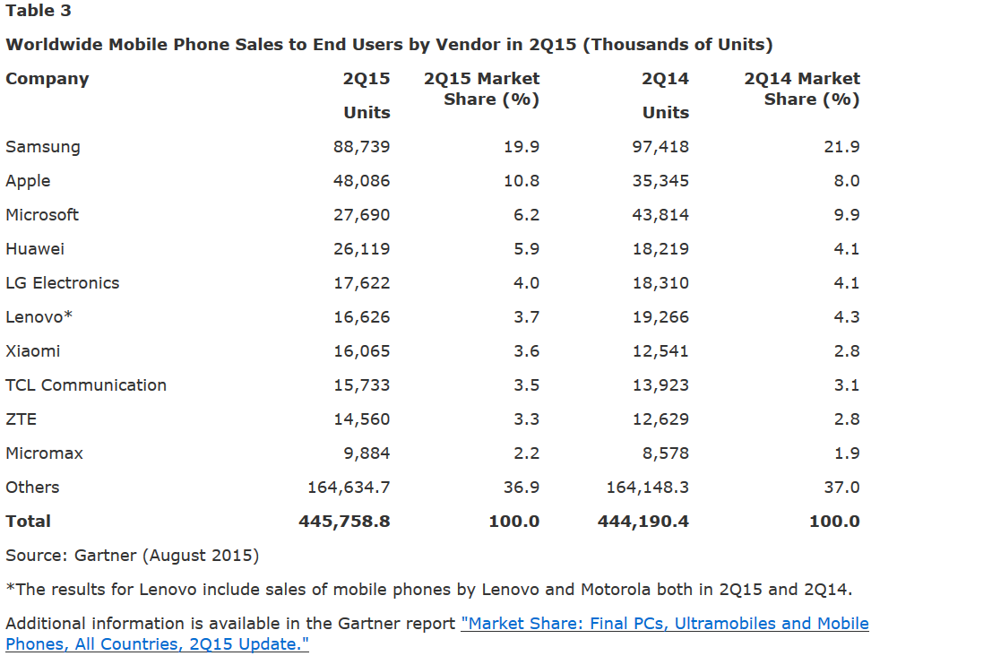

Slide 53
Android
Android was developed by Google and is based upon a modified version of the Linux kernel
It was initially developed by Android Inc. (a firm purchased by Google) and later positioned in the Open Handset Alliance
According to NPD Group, unit sales for Android OS smartphones ranked first among all smartphones OS handsets sold in the U.S. in the second quarter of 2010, at 33%. BlackBerry is second at 28%, and iOS is ranked third with 22%

Slide 54
Android features
Application framework enabling reuse and replacement of components
Dalvik virtual machine optimized for mobile devices
Integrated browser based on the open source WebKit engine
Optimized graphics powered by a custom 2D graphics library; 3D graphics based on the OpenGL ES 1.0 specification (hardware acceleration optional)
SQLite for structured data storage
Media support for common audio, video, and still image formats (MPEG4, H.264, MP3, AAC, AMR, JPG, PNG, GIF)
GSM Telephony (hardware dependent)
Bluetooth, EDGE, 3G, and Wi-Fi (hardware dependent)
Camera, GPS, compass, and accelerometer (hardware dependent)
Rich development environment including a device emulator, tools for debugging, memory and performance profiling, and a plug-in for the Eclipse IDE

Slide 55
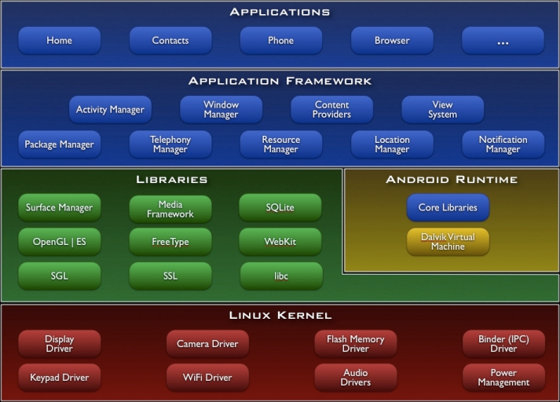
Android architecture http://developer.android.com/images/system-architecture.jpg

Slide 56
Extended Application
…
…
Applications
Reference Monitor
Component Framework
JVM
Middleware
Policy Set
Linux OS

Slide 57
Java applications
Java has built-in security: bytecode generation, array bounds checking, and JVM security libraries
An application is restrained by a sandbox where each package has a predefined set of rights (Controlled Domain pattern)
The JVM can define policies (patterns for access rules) and a Reference Monitor to enforce the rules (RM pattern)

Slide 58
Controlled execution domain

Slide 59
Components
Android applications are built out of components
They interact via components
Use OpenBinder component framework
Each application runs with a Linux userID (a Linux process)
Component types: Activity, Server, Content provider, Broadcast receiver

Slide 60
Activity interactions
Activities can call activities or services or content providers
Can receive from any component
An intent is a request for something
The target activity can be in another application
Services can be local or remote

Slide 61
Manifest file
Packaged with each application
Components
Runtime libraries
Permissions for its own resources (to be granted to others)
Permissions used (own or imported)

Slide 62
Application Threats
Hacker takes over application to read/modify its data or its extended application
Application attacks other applications or their extended applications
Applications attack the middleware
Applications attack the Linux kernel
Applications attack external systems

Slide 63
Possible certifications
The application has only needed rights and security mechanisms considering extended application--Model-driven and based on secure development methodology
The application code has no exploitable vulnerabilities that can be used for attacks--Code-based (Java is a secure language, e.g.most cases of buffer overflow are not possible)

Slide 64
Android phones security
The Froyo 2.2 version of Google’s Android OS for smartphones such as the Motorola Droid and HTC Incredible doesn't support on-device encryption, making it incompatible with security settings at many businesses
However, some users are reporting that their Droids can connect to such networks, despite the policy mismatch. That indicates some Android smartphones are lying about their security compliance.
The Microsoft Exchange email server has a tool called Exchange Active Sync (EAS), that lets IT set policies for a device to access the server. One common policy at many companies is requiring that the device encrypt any data stored on it. Many states' law requires such encryption be enabled on devices that contain customers' and employees' data
Android users can install the NitroDesk Touchdown app or a mobile management app such as that from Good Technologies to create an encrypted workspace on their Android smartphones. These apps then manage email and keep it encrypted in those workspaces, which complies with the EAS policy requirement. Without such apps, Android does not support the EAS on-device encryption policy.

Slide 65
Android security app
http://www.infoworld.com/d/mobile-technology/8-essential-android-security-apps-177&current=3&last=2&auto=y#slideshowTop
mSecure Password Manager
Developer: MSeven Software Price: $4.99
This app specializes in encrypting and storing important information and passwords, including bank account numbers, Social Security numbers, email log-in passwords and more. The app utilizes 256-bit Blowfish encryption and has a password protection "hint" feature that asks you questions to help remember passwords. Additionally, the app features an automatic password generator that helps create strong passwords for accounts.

Slide 66
Android malware
Several security vendors reported new mobile malware variants surfaced, targeting users of Google's Android mobile platform. The main goal of cybercriminals is to target as many devices as possible.
In addition to other more sophisticated features, the Android malware uses an old-school technique by including a feature that prompts a victim's smartphone to send costly text messages. The malware was hidden in altered versions of legitimate applications hosted on unregulated third-party Android marketplaces, according to researchers at Symantec Corp.
Symantec said the Android malware, Android.Pjapps, masquerades as a legitimate "Steamy Window" app, but the cybercriminals altered the original app, adding functionality that allows an attacker to build a botnet. Symantec said a malicious service installed with the application that periodically checks a command-and-control server to check and pull down new commands.
Symantec said the hidden malware was also coded to allow an attacker to "install applications, navigate to websites, add bookmarks to the user's browser, send text messages and block text message responses. It also sends sensitive user information back to the attacker."

Slide 67
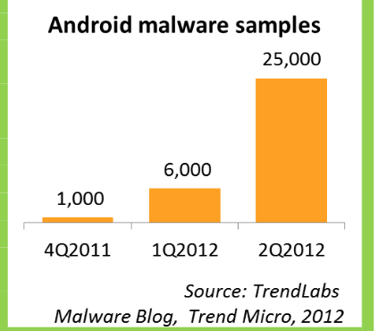

Slide 68
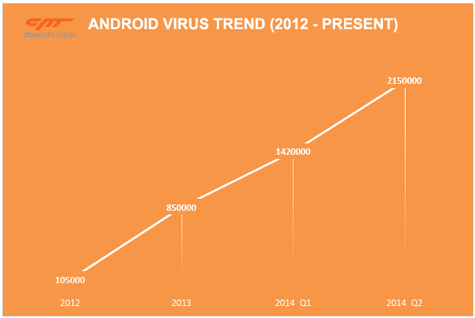

Slide 69
87% of Android devices are exposed to at least one critical vulnerability https://nakedsecurity.sophos.com/2015/10/15/87-of-android-devices-are-exposed-to-at-least-one-critical-vulnerability/?utm_source=Naked%2520Security%2520-%2520Feed&utm_medium=feed&utm_content=rss2&utm_campaign=Feed&utm_source=Naked+Security+-+Sophos+List&utm_campaign=913c01c6b4-naked%252Bsecurity&utm_medium=email&utm_term=0_31623bb782-913c01c6b4-455135885
According to research from the UK's University of Cambridge - 87% of Androids are exposed to at least one known critical vulnerability.
Android device buyers often don't have any guidance on which device models are getting security patches or on what kind of timetable, researchers Daniel Thomas, Alastair Beresford, and Andrew Rice note in a new paper.
Not all device manufacturers are equally lagging in patching devices.
The study found that Google, LG, and Motorola far outperformed Samsung, HTC and Asus.
Nexus devices do considerably better, and LG is the best manufacturer of all.
Still, few devices are promptly updated: the study found that, on average, a device receives 1.26 updates per year, leaving them unpatched for long periods.
Data collected from 20,400 Android devices with the university's Device Analyzer app installed revealed that 87% of Android devices were vulnerable to at least one of 11 known, critical bugs, including the TowelRoot and FakeID vulnerabilities discovered in 2014.

Slide 70
The November security update for Nexus devices fixes seven vulnerabilities, two of them critical http://www.networkworld.com/article/3000435/google-patches-critical-media-processing-flaws-in-android.html?phint=newt%3Dnetworkworld_security_alert&phint=idg_eid%3Dc30d380502694c47d2c45cb7576fbd6b#tk.NWWNLE_nlt_security_2015-11-03
New security patches for Google's Nexus devices address seven vulnerabilities, two of which are critical and could allow for remote code execution when handling media files.
The updates, released on Monday, are part of Google's recently introduced monthly patch cycle and are available for Nexus devices running both Android 5.1 (Lollipop) and 6.0 (Marshmallow). The source code for the fixes will also be added to the Android Open Source Project (AOSP) over the next 48 hours.
The most serious flaws patched in this release are tracked as CVE-2015-6608 and CVE-2015-6609, and are located in the mediaserver and libutils components of Android, respectively. Both vulnerabilities can be exploited remotely through specially crafted media files.

Slide 71
Android malware https://www.lookout.com/resources/reports/mobile-threat-report
ScarePackage | Ransomware
ScarePakage masquerades as an Adobe Flash update or a variety of anti-virus apps, and is distributed as a drive-by-download. When downloaded, it pretends to scan victims’ phones and then locks the device after falsely reporting that its scan found illicit content. ScarePakage then displays a fake message from the FBI and attempts to coerce victims into paying them to avoid criminal charges and regain control of their device.
DeathRing | Trojan
DeathRing poses as a ringtone app and then surreptitiously downloads fake SMS content to infected devices, in a possible attempt to capture victim login credentials by impersonating trusted entities like banks via SMS. Notably, DeathRing appears to come pre-installed on certain devices, suggesting its authors were able to infiltrate the device supply chain and inject their malware into factory-shipped devices

Slide 72
More
NotCompatible | Malware
NotCompatible is a trojan that surreptitiously acts as a network proxy, allowing attackers to send and receive traffic through a victim’s mobile device onto connected networks for fraudulent purposes.
Koler | Malware
Koler is a trojan disguised as a media app that then locks a victim’s device after falsely reporting the discovery of illegal activity. Koler attempts to coerce victims into paying them to avoid criminal charges and regain control of their device.
ScareMeNot | Malware
ScareMeNot is a trojan that pretends to scan victims’ phones for security issues and then locks their device after falsely reporting that its scan found illicit content. It attempts to coerce victims into paying them to avoid criminal charges and regain control of their device.

Slide 73
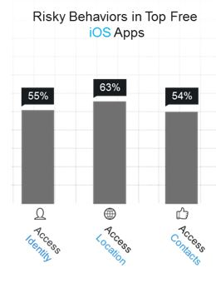
iPhone risky behavior

Slide 74
Security comparison
Apple apps can only be bought in AppleStore, where they are possibly checked or come from trusted sources
iPhone has only one architecture, controlled by Apple
Android phones are made by several companies who interpret the architecture in their way
Android apps can be bought in many places
In general, Android phones are easier to attack
Final effect depends on security defenses and their use by the phone owners

Slide 75
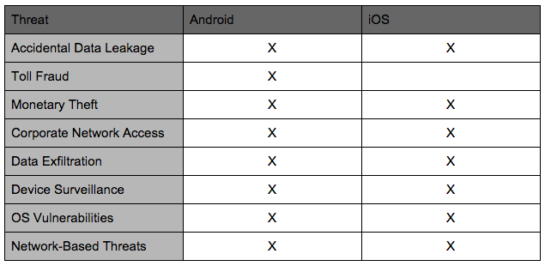
Android vs iOS malware

Slide 76
Comparison Android Knox-- iPhone
Android Knox Security Mechanisms: | iPhone Security Mechanisms:
Android OS kernel partition applies the “sandbox” principle – separation of kernel and user modes; Knox goes further, only using middleware to allow cross-application communication and to manage kernel requests. This also helps ensure no forms of communication occur between the Knox OS and the normal Android OS. | iOS kernel partition applies the “sandbox” pattern, protected from alteration by user app
Android OS uses Java code, which is largely immune to buffer overflow vulnerabilities | iOS mitigates buffer overflow vulnerability with mechanisms that manage memory and prevent the causes of buffer overflow
Secure boot uses asymmetric key pair and hardware encoding to verify signed components of executables | Secure boot process, using asymmetric key and signed components are verified as loaded

Slide 77
Android Knox and iPhone
Knox creates a virtual partition within OS, allowing two separate Android OS to be run. This allows complete separation of personal and professional data and applications. | Secure Enclave – separate boot process, encrypted data, isolated from the rest of the system. Communicates with rest of OS is limited to shared memory buffers and interrupt-driven mailbox communications. Provides all cryptographic operations and data integrity, and is able to operate even if kernel has been compromised.
Knox container is encrypted with AES 256 bit key | Uses AES 256-bit encryption for data.
Two-part biometric authentication can be set with a fingerprint scan and passcode requirement | Touch ID - Fingerprint passcode system allows two-part biometric authentication
Cryptographic key is tied to unmodifiable hardware values – so that software and data may only be used on the hardware it was encrypted on | Each key is unique and partially generated from and tied to the device it is used on – software and firmware are unable to read this key directly.

Slide 78
Knox Warranty Fuse – one-time fuse that is triggered if the device is ever booted to an unapproved state. If so – the device can never run Knox again, and the data from the Knox OS can never be recovered. | Option can be set to have device completely wiped if passcode is entered incorrectly on 10 consecutive attempts.
Google Play Store: No checking of applications before available for download – Google will run scan of the store regularly to detect malware. Bad programs can exist for download before detected. | Apple Store apps are checked and verified and receive a unique certificate before publishing for user download. Only Apple-signed code can be installed.
42 OS vulnerabilities known for Google Android OS (as of 3/15/15) | 454 OS vulnerabilities known for iPhone iOS (as of 3/15/15)
Access requests by apps are granted during installation | Access requests by apps are granted as requested

Slide 79
L4 Microvisor
L4 Microvisor from OK Labs (Australia)
Runs as 'host' OS
Microkernel architecture
Limited execution in kernel mode
Real-time capabilities for communication stack and media streaming
seL4 mathematically proven correct, 08/09
Used in several smartphones

Slide 80
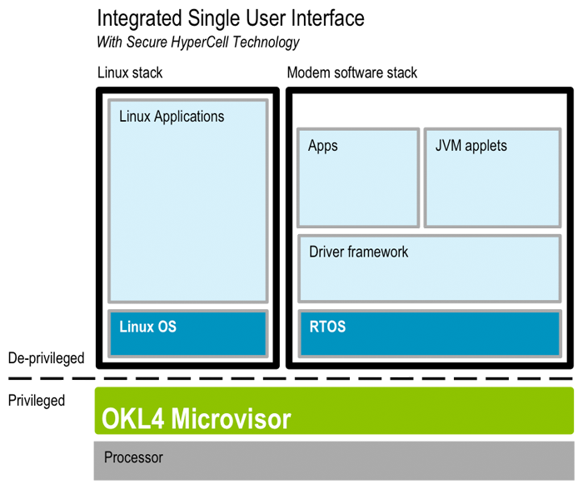
L4 Microvisor

Slide 81
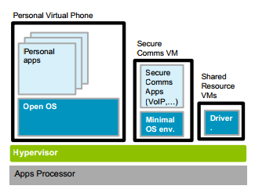
Secure communications in standard phone

Slide 82
The Microkernel pattern (www.vico.org)
"The Microkernel architectural pattern applies to software systems that must be able to adapt to changing system requirements. It separates a minimal functional core from extended functionality and customer-specific parts. The microkernel also serves as a socket for plugging in these extensions and coordinating their collaboration." (Buschmann, F., R. Meunier, H. Rohnert, P. Sommerlad, and M. Stal. Pattern-Oriented Software Architecture: A System Of Patterns. West Sussex, England: John Wiley & Sons Ltd., 1996)
The microkernel includes functionality that enables other components running in separate processes to communicate with each other. It is also responsible for maintaining system-wide resources such as files or processes. In addition, it provides interfaces that enable other components to access its functionality.

Slide 83
Microkernel
3/19/2017
83

Slide 84
Chromium
Chromium OS is the open-source development version of Chrome OS, which is a Linux distribution designed by Google to work primarily with web applications. The OS’s architecture is three-tiered:
The firmware contributes to fast boot time by not probing for hardware, such as floppy disk drives, that is no longer common on computers, especially netbooks. The firmware also contributes to security by verifying each step in the boot process and incorporating system recovery.
System-level software includes the Linux kernel that has been patched to improve boot performance. Userland software has been trimmed to essentials, with management by Upstart, which can launch services in parallel, re-spawn crashed jobs, and defer services in the interest of faster booting.
The window manager handles user interaction with multiple client windows much like other X window managers.

Slide 85
Chrome security
In March 2010, Google software security engineer Will Drewry discussed Chrome OS security. He described Chrome OS as a "hardened" operating system featuring auto-updating and sandbox features that will reduce malware exposure.
He said that Chrome OS netbooks will be shipped with Trusted Platform Module (TPM), and include both a "trusted bootpath" and a physical switch under the battery compartment that actuates a developer mode. That mode drops some specialized security functions but increases developer flexibility. Drewry also emphasized that the open source nature of the operating system will contribute greatly to its security by allowing constant developer feedback.
At a December 2010 press conference, Google claimed that Chrome OS would be the most secure consumer operating system due in part to a verified boot ability, in which the initial boot code, stored in read-only memory, checks for system compromises.

Slide 86
BlackBerry
BlackBerry OS is a proprietary OS, developed byResearch in Motion (RIM)
The operating system provides multitasking and supports specialized input devices that have been adopted by RIM for use in its handhelds, particularly the trackwheel, trackball, trackpad, and touchscreen
BlackBerry provides a granular ability to encrypt all data on the device, including data stored on peripheral flash memory cards (e.g., SD cards).
Further, policy setting flexibility allows the selective encryption of data, enabling protection for company sensitive and personal data, but also providing for non-critical data (e.g., personal music files, images) to be stored unencrypted. This allows the device to use less processing power when retrieving the information and presenting it to the user, and ultimately can increase battery life.
Data can also be selectively encrypted and protected on an application level to prevent unauthorized applications from accessing sensitive or confidential data.
Finally, encryption can also be enabled in such a way that data is either locked to a user (via password) or locked to a user and device so moving the data to other devices is impossible.

Slide 87
Linux
The Linux Phone Standards Forum (LiPS Forum) is a consortium to create standards for the use of Linux on mobile devices
The main goal of the LiPS Forum is to create APIs that will allow developers to build applications to inter-operate across Linux handsets made by all manufacturers
Mobilinux is a distribution of the Linux OS, targeted to smartphones. It was announced by Montavista Software on April 25, 2005.
Mobilinux is based on open source and open standard technology, designed for scalability and maximized battery power usage for single-chip mobile phones. More than 35 million phones and other mobile devices run on Mobilinux, far more than any other commercial Linux.^{[1]}

Slide 88
Symbian
Symbian Os is a hard RTOS
Symbian OS is an open system and is based on a micro kernel architecture which implements full multitasking and multithreading
The micro kernel uses client/server session based IPC in which servers mediate access to shared resources and services, and the kernel deals with memory allocations and IPCs
System services such as telephony, networking middleware and application engines all run in their own processes
Symbian OS v9.1 provides a proactive defense mechanism against malware. The platform security infrastructure uses a capability-based model, which ensures that sensitive operations (for example modifying user data, making calls, using network connections) can only be accessed by applications, which have been certified by an appropriate signing authority
Data caging is a new feature provided by the Symbian OS v9, which allows applications to have their own private data partition. This allows for applications to guarantee a secure data store. This can be used for e-commerce, location applications and others.

Slide 89
Symbian
Symbian platform releases are called Symbian^1, Symbian^2 etc.
Although scheduled for mid-2010, the Symbian^3 platform was made available on 4 February 2010. Symbian Foundation reports this event to be the largest codebase transitioned to Open Source in history
Access to the full source code of an earlier release of the Symbian platform, Symbian^2, is still limited to member organizations, but membership is open to any organisation

Slide 90
Symbian layered microkernel

Slide 91
Symbian security
Since a phone has only single user, the main concern here is not to protect different users from each other, as in a desktop environment
Instead, the OS controls what applications are allowed to do when they run
Therefore the unit of trust is the OS process, since this is already the fundamental unit of memory protection in Symbian OS
If a number of threads are running in the same process, the kernel cannot protect individual threads from each other because they all have access to the same memory.

Slide 92
Security features of EKA2 kernel
When an access request is made from within privileged code (that is, the kernel and device drivers) to the user mode memory, it uses special accessor and copy functions in order to apply user-mode memory permissions on the access. This mechanism makes sure that invalid data pointers passed to kernel functions by user processes do not cause kernel to fail.
Thread stacks and heaps are declared as ‘private’ chunks: only the owner can map and access these chunks and no other process can access them.
When the kernel allocates memory to processes, it overwrites it with zeroes to prevent any private data from the previous owner being accessible to the new process.
Parameters passed in an IPC request are strictly checked. Their lengths are also specified, even in the case of a pointer, to ensure that the server will not read or write more than the client expected to disclose: any attempt to read before the pointer’s address or after its length fails.
EKA2 also enforces “ARMv6 never execute bit” in the page permissions when supported by the hardware. This is used to deny execution of code from stacks, heaps and static data. The goal of this protection is to prevent buffer-overflow attacks. Execution is only allowed from execute-in-place ROM images, software loaded by Symbian OS loader and explicitly created ‘local code’ chunks (for Java JIT/DAC etc.).

Slide 93
Symbian capabilities
A capability represents a row of the access matrix and gives access to system resources
Capabilities are like tickets assigned to processes
One capability for the TCB, system capabilities, and user capabilities
TCB cap can create new processes, assign caps to processes,…
System caps include: AllFiles (read access to all files), DiskAdmin (access to file admin ops), Networkcontrol (read or modify network protocol controls), WriteDeviceData,….
User caps: LocalServices, Location, NetworkServices, ReadUser Data, WriteUserData….

Slide 94
Windows Phone
Windows Phone (WP) is a family of mobile operating systems developed by Microsoft for smartphones as the replacement successor to Windows Mobile and Zune.
Windows Phone features a new user interface derived from Metro design language. Unlike Windows Mobile, it is primarily aimed at the consumer market rather than the enterprise market.
It was first launched in October 2010 with Windows Phone 7. Windows Phone 8.1 is the latest public release of the operating system, released to manufacturing on April 14, 2014.
Windows 10 Mobile succeeded Windows Phone 8.1 in late 2015; it emphasizes a larger amount of integration and unification with its PC counterpart—including a new, unified application ecosystem, along with an expansion of its scope to include small-screened tablets.

Slide 95
Windows Phone security is top notch, says Kaspersky http://betanews.com/2015/06/11/windows-phone-security-is-top-notch-says-kaspersky/
In an interview with ITWire, Kaspersky has discussed the major mobile operating systems, for desktops and mobile devices, from a security standpoint, with Windows Phone being the only competitor in the mobile market to be mentioned in a positive light. "So far very clean", says Kaspersky.
Kaspersky has not detailed what makes Windows Phone "very clean" or why there are not as many attempts to break its security protections, compared to Android and iOS.
What's more, Kaspersky sees Windows 10 as only getting better with regards to security. "Windows is a much better operating system than the rest (iOS, OS X and Android) and Microsoft is tightening it up much more in the next version".

Slide 96
Samsung Bada
Bada (stylized as bada; Korean: 바다) was an operating system for mobile devices such as smartphones and tablet computers. It was developed by Samsung Electronics. Its name is derived from "바다 (bada)", meaning "ocean" or "sea" in Korean. It ranges from mid- to high-end smartphones.^{[3]}
To foster adoption of Bada OS, since 2011 Samsung reportedly has considered releasing the source code under an open-source license, and expanding device support to include Smart TVs. Samsung announced in June 2012 intentions to merge Bada into the Tizen project, but would meanwhile use its own Bada operating system, in parallel with Google Android OS and Microsoft Windows Phone, for its smartphones.
On 25 February 2013, Samsung announced that it will stop developing Bada, moving development to Tizen instead. Bug reporting was finally terminated in April 2014

Slide 97
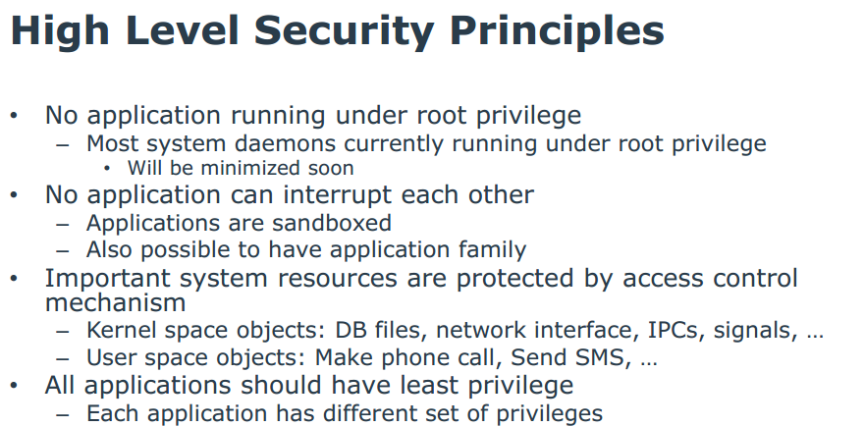
Tizen OS principles

Slide 98
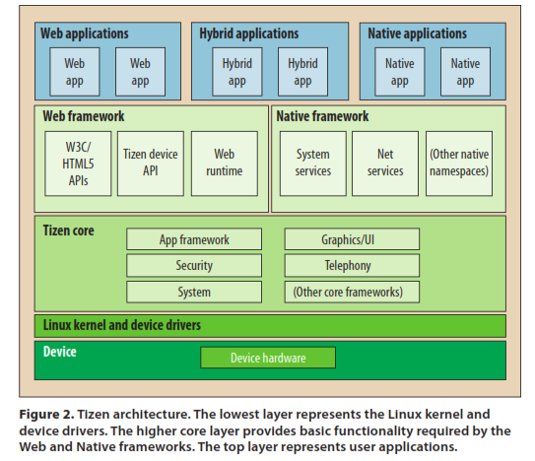
Tizen OS

Slide 99
Patterns in Tizen OS
Layers
Controlled VAS (Sandbox)
Multilevel Access Control (Mandatory)
Digital Signature

Slide 100
Review: Silent Circle Blackphone 2 http://www.wired.com/2015/09/review-blackphone-2/
The Blackphone 2, the second device from the Swiss company Silent Circle, is unique.
It promises a fully private experience, with advanced security features, deep permissions management, and encrypted voice, text, and video chat built in.
The phone, which runs a heavily modified version of Android, lets you fiddle with the most granular permissions settings of all your apps, giving you a level of privacy control that far exceeds that of regular Android phones. Your communications travel encrypted across Silent Circle’s private cloud VPN
The Blackphone 2 is sold unlocked for $799, and it will work on any LTE or 3G/HSPA+ network. You just pop in a Nano SIM of your choosing.
The company partnered with Qualcomm to create a chip that can be securely partitioned, so the user can set up unique “Spaces,” keeping work and personal stuff separate. Each space has its own privacy settings, its own app permission settings, and its own allocation of system storage

Slide 101
QNX
QNX is a Unix-like real-time OS , aimed primarily at the embedded systs market. The product was originally developed in the early 1980s by Canadian company Quantum Software Systems and ultimately acquired by BlackBerry in 2010.[
QNX was one of the first commercially successful microkernel operating systems
It is used in a variety of devices including internet routers, flight simulators, air traffic control, shipping navigation systems, high speed train controllers, in-car infotainment and control systems, warehouse distribution systems, cable TV delivery, Hollywood special effects systems, smartphones, mobile devices, hospital/medical technology (e.g. ECG machines, angiography, cardic monitors, cancer treatment, LISIK systems), casino gaming systems, and more.

Slide 102
OS comparison
http://www.computerworld.com/s/article/9214206/Smartphone_OS_shootout_Android_vs._iOS_vs._Windows_Phone_?source=CTWNLE_nlt_dailyam_2011-03-17
Compares the platforms in several different categories, including ease of use, app availability, features, integration with desktop and Web-based apps, customization and platform openness.
Comparison of OS security: http://www.digitaltrends.com/computing/decrypt-os-security-showdown/

Slide 103
Hardware: ARM
The ARM is a 32-bit Reduced-Instruction Set Computer (RISC), developed by British company ARM Holdings.
It was known as the Advanced RISC Machine, and before that as the Acorn RISC Machine
The ARM architecture is the most widely used Instruction Set Architecture (ISA) in terms of numbers produced.
They were originally conceived as a processor for desktop personal computers
The relative simplicity of ARM processors made them suitable for low power applications. This has made them dominant in the mobile and embedded electronics market

Slide 104
ARM II
As of 2007, about 98 percent of the more than one billion phones sold each year use at least one ARM processor.
As of 2009, ARM processors account for approximately 90% of all embedded 32-bit RISC processors
ARM processors are used extensively in consumer electronics, including PDAs, mobile phones, digital media and music players, hand-held game consoles, calculators and computer peripherals such as hard drives and routers

Slide 105
ARM Security
The Security Extensions (TrustZone Technology), is found in ARMv6KZ and later application profile architectures.
It provides a low cost alternative to adding an additional dedicated security core to a chip, by providing two virtual processors backed by hardware based access control
This enables the application core to switch between two states, referred to as worlds, in order to prevent information from leaking from the more trusted world to the less trusted world.
This world switch is generally orthogonal to all other capabilities of the processor, thus each world can operate independently of the other while using the same core.
Memory and peripherals are for controlling the use of media on ARM-based devices, and preventing any unapproved use of the device.

Slide 106
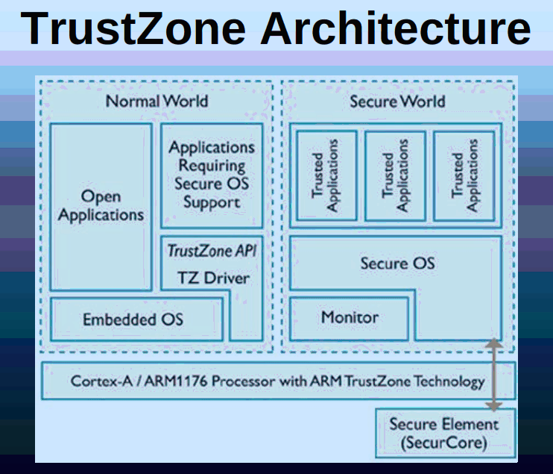

Slide 107
ARM Sec II
Typical applications of TrustZone Technology are to run a rich operating system in the less trusted world, and smaller security-specialized code in the more trusted world (known as TrustZone Software, a TrustZone optimized version of the Trusted Foundations(TM) Software developed by Trusted Logic), allowing much tighter access control for the use of media on ARM-based devices, and preventing any unapproved use of the device.
In practice, since the specific implementation details of TrustZone are proprietary and have not been publicly disclosed for review, it is unclear what level of assurance is provided for a given threat model.
See: https://www.blackhat.com/docs/us-14/materials/us-14-Rosenberg-Reflections-on-Trusting-TrustZone.pdf
As of ARMv6, the ARM architecture supports no-execute page protection, which is referred to as XN, for eXecute Never

Slide 108
Phone application security
Two security researchers at the SecTor 2010 conference demonstrated a variety of mobile application security vulnerabilities, which they say are similar to errors made by developers coding early Web applications.
Mobile applications made for a variety of mobile platforms -- including Apple's iOS, Research In Motion Ltd.'s BlackBerry OS and Google's Android operating system -- contain coding errors that could lead to data leakage or privilege-escalation vulnerabilities, according to application security experts Mike Zusman and Zach Lanier of New York-based security consultancy Intrepidus Group. The work presented was based on penetration tests conducted on a variety of mobile applications, using tools to decompile code, find bugs and gain access to confidential data or cause the application to function abnormally.
Coding experts say the smartphone marketplaces have fostered a new wave of developers, often less skilled, building applications as quickly as possible to gain as much visibility and profit as they can.
In addition, applications that sync data between a device and the cloud have authentication and authorization bugs, leaving them open to attack by a savvy hacker. The issues are often found on the server side when the mobile application talks to the server to retrieve data. Researchers have also been studying ways to access mobile application data cached on the device to tap into apps that may be leaking information, Lanier said.

Slide 109
--Apple Bans Apps Created with Advertising SDK That Collects Personal Data (October 19, 2015) SANS News Bites, Vol. 17, No 82
Apple has identified and pulled more than 250 apps from its App Store because they were created using a third-party advertising SDK (software development kit) that harvests user data and sends them back to a remote server. The SDK in questions is "developed by Youmi, a mobile advertising provider [and] uses private APIs to gather private information." The developers may not have been aware that the SDK included questionable functions. http://www.zdnet.com/article/apple-pulls-hundreds-of-ios-apps-using-private-sdk-from-china-to-gather-user-data/ http://www.nbcnews.com/tech/security/apple-bans-hundreds-apps-hid-chinese-spyware-n447236

Slide 110
Security requirements for mobile devices
Secure processor
Secure OS
Resource access control in the device
Application security
Secure communication protocols
Appropriate server security
Authentication of users to devices
3/19/2017
110

Slide 111
WiFi threats
Attacker can set up its own AP
Intercept wireless printer traffic
OS attacks through the network
Denial of Service (RF signal jamming)

Slide 112
Sony attack
In early 2012, Sony’s online network for the PlayStation suffered a catastrophic hacking attack. And for a while, the roughly 77 million gamers worldwide who have accounts for the service were unable to play games with friends through the Internet or to download demos of new games.
Sony said that as a result of the attack, an “unauthorized person” had obtained personal information about account holders, including their names, addresses, e-mail addresses, and PlayStation user names and passwords. Sony warned that other confidential information, including credit card numbers, could have been compromised
After the attack, Sony said it would rebuild the network to make it more secure. The Sony Qriocity service, which is used to stream audio and video, was also knocked offline.
“It is very unusual for Sony to completely rebuild a system after a security breach, rather than just stopping the bleeding and going back to some kind of restricted network,” said Mark Seiden, an information security consultant. “The fact that two separate networks are involved in this security breach suggests Sony discovered a major underlying problem that already existed.”
Senator Richard Blumenthal, Democrat of Connecticut, asked why customers had not been notified immediately about the security breach and not told for nearly a week about the extent of the attack. Mr. Blumenthal also cited concerns that many PlayStation users are children.

Slide 113
Sony breach October 23 & 24, 2012
A US District Court judge in California has dismissed the bulk of a class-action complaint brought against Sony over the April 2011 PlayStation Network (PSN) data security breach that affected more than 75 million customer accounts.
The lawsuit sought restitution for lost access to Netflix and other paid services while PSN was down for more than a month. Judge Anthony J. Battaglia noted that Sony's terms of service state that "no warranty is given about the quality, functionality, availability, or performance of Sony Online Services, or any content or service offered on or through Sony Online Services," and that PSN's privacy policy states that "there is no such thing as perfect security [and that Sony] cannot ensure or warrant the security of any information transmitted" to the company through PSN. Plaintiffs have until November 9, 2012, to amend and resubmit their complaints.
It was a failure of due diligence in the part of Sony, the judge does not understand security (EF)
http://arstechnica.com/gaming/2012/10/judge-sony-didnt-promise-perfect-security-isnt-liable-for-psn-hack/ http://www.scmagazine.com/judge-dismisses-brunt-of-sony-breach-lawsuit/article/265026/

Slide 114
References
Olga Gadyatskaya; Fabio Massacci; Yury Zhauniarovich, “Security in the Firefox OS and Tizen Mobile Platforms”, Computer , 2014, Volume: 47, Issue: 6 , 57 - 63, DOI: 10.1109/MC.2014.165

